Slide 1

Text similarity
Nalani Schumacher

Slide 2
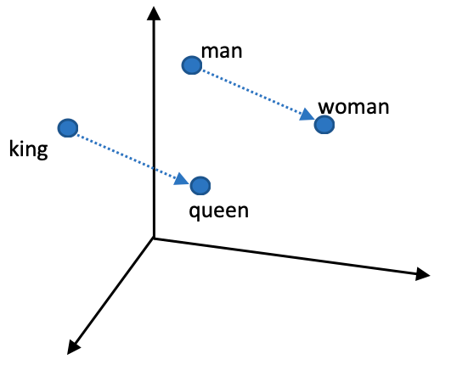
Background
Large natural language models with contextual, semantic word embeddings allow for text comparison
Text similarity ranking
Words
Short Phrases
Text pre-processing
Spelling
Profanity

Slide 3
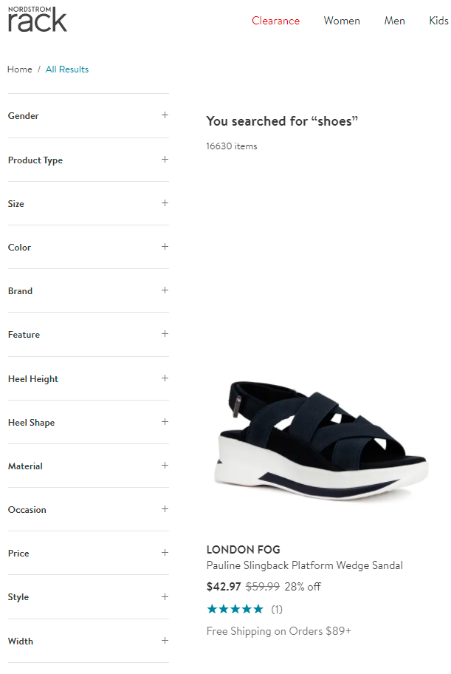
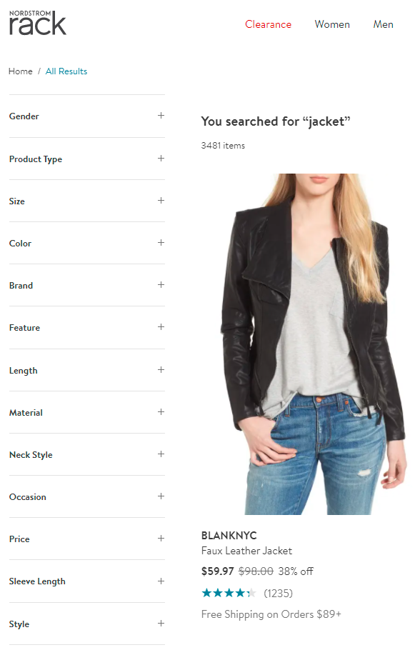
Use Cases
Given a query
Get related key words and phrases

Slide 4
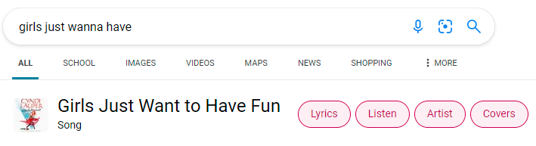
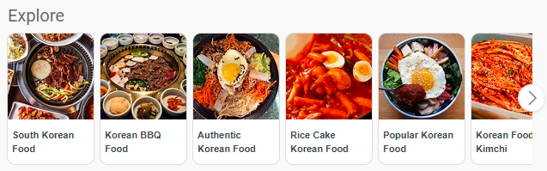
Use Cases
Given a query
Get related key words and phrases

Slide 5
DEMO

Slide 6
Design
Textsimilarity package has 3 modules separated by functionality and purpose
Cleaning text
Class to load supporting dictionaries and instances only once during initialization
Private method for calculating the Jaccard distance as a helper for spelling correction
Loading a language model
One class per model to load
Private methods for tokenizing data and retrieving text embeddings
Ranking a text corpus
One class per ranker
Private methods for calculating cosine similarity and creating a dictionary of embeddings

Slide 7
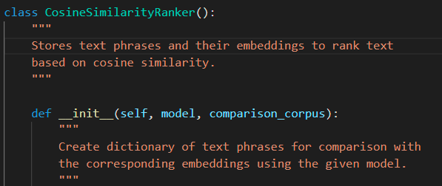
Design
The ranker objects in the rankers module take in a language model as an input parameter.
Allows language model complexity to remain abstracted from the user.
Calls private methods in the model object to tokenize the data and get embeddings.
To rank the corpus based on a given text, the user just needs to call rank_on_similarity() passing in the target text.

Slide 8
Design
The CleanText object allows users to have better ranked results by not including profane text and by correcting spelling errors; however, if for instance a user knew their text was already clean then they could choose to save time and skip this step. Then they could continue to use the text_models and rankers modules as normal.

Slide 9
Project Structure

Slide 10
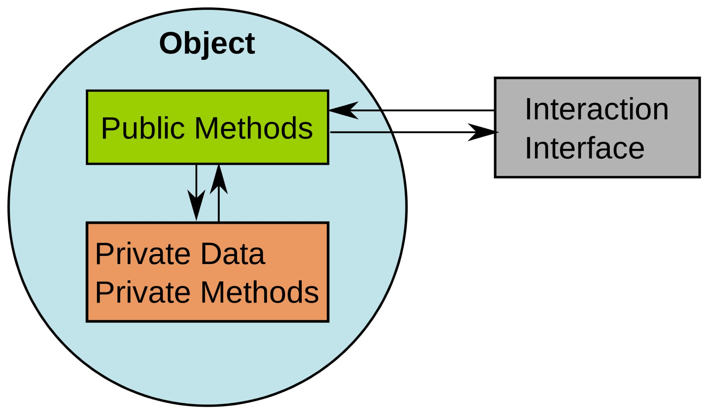
Lessons Learned
Tools
Travis-CI
Run all tests & generate coverage report
Unittest
Set up / tear down methods
Design
Verb or action prefix on methods for clarity: “calculate”, “get”, “tokenize”, “rank”
Easier to understand, clearer expectations
Separating functionality: modules, classes, methods
Easily extendable and modifiable
Abstraction, information hiding
Easier to use

Slide 11

Future Work
In the package:
Cross-modality expansion such as with text to image similarity
In the clean text module and text models module:
Add support for other languages besides English
In text models module:
Add more natural language models
In the rankers module:
Add other rankers

